Slide 1
Impacts of TKO/KO losses for a UFC fighter
A study by: Artem Petrishchev & Kobe Louis

Slide 2

Table of contents
1. Introduction
2. Data Scraping and Overview
3. Remarks/Limitations
4. Data Cleaning
5. Methodologies
6. Analysis
7. Conclusion
8. Future Work
9. References

Slide 3

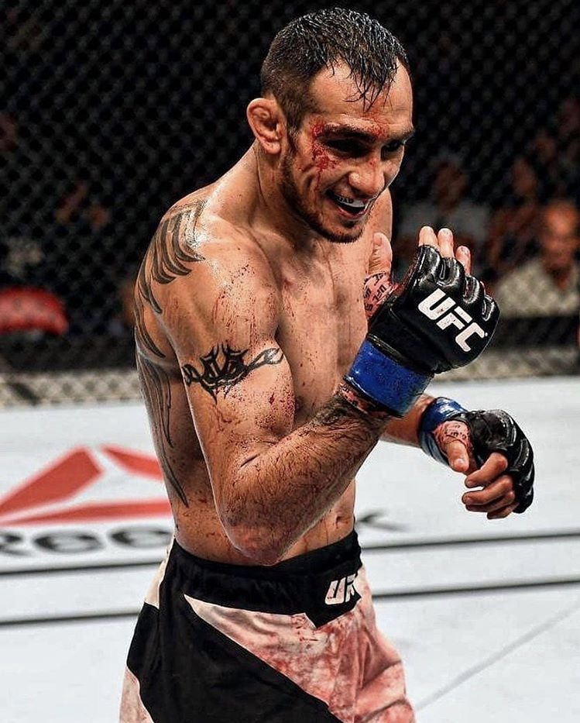
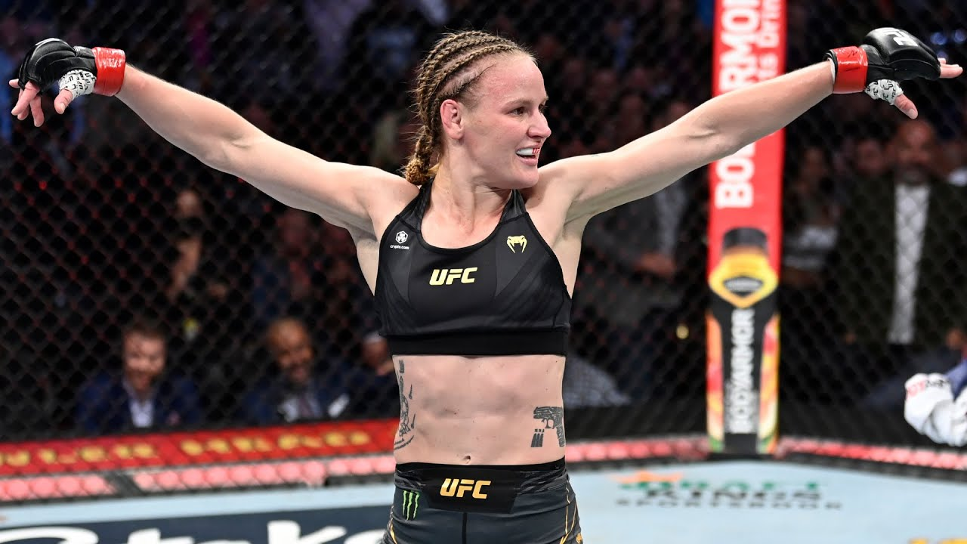
Introduction
What is the UFC and why ?
- Ultimate Fighting Championship
- Considered the gold standard of MMA competition worldwide
- best fighters around the globe compete at the UFC
What is TKO/KO ?
- TKO ( Technical Knockout )
- Unable to continue due
to damage received
- KO ( Knocked out )
- Unconscious Fighter
i.e ( Knockout blow to
the head )

Slide 4
Purpose/Goal
This study will explore the impact of TKO/KO’s losses on a UFC fighter’s career and what aspects can contribute to the likeliness of getting TKO/KO’ed
- TKO ( Technical Knockout ) and KO ( Knockout ) are common
- Fighters may suffer from concussions, brain trauma, and other head injuries (i.e CTE )
- Repeated TKO/KO’s can lead to long-term cognitive impairments and neurodegenerative diseases.
- These injuries can significantly impact a fighter’s career and quality of life
- Therefore, studying the impacts of TKO/KO losses we can gain insights into the dynamics of fighting and ultimately preserve the longevity of fighters careers, in the unforgiving world that we call MMA. ( Mixed Martial Arts )

Slide 5
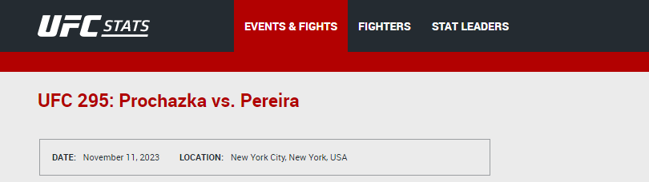
Data Scraping & Overview
The data was collected from the UFC stats main webpage
http://ufcstats.com/statistics/events/completed
Specifically, the fighter events and fighter details
Utilized a web scraper to extract excel sheets

Slide 6
Data Collected
Collected various types of data on fighter ( notable features )
SLpM - Significant Strikes Landed per Minute
Str. Acc. - Significant Striking Accuracy
SApM - Significant Strikes Absorbed per Minute
Str. Def. - Significant Strike Defense (the % of opponents strikes that did not land)
TD Avg. - Average Takedowns Landed per 15 minutes#
TD Acc. - Takedown Accuracy#
TD Def. Takedown Defense (the % of opponents TD attempts that did not land)
Sub. Avg. - Average Submissions Attempted per 15 minutes
Age – is recorded at the day of the bout
Height
Weight
Fighter Record
Outcome of the fight, ended via ( TKO/KO, Sub = Submission, Dec = Decision, NC= No contest, DQ = Disqualification
Date of the fight

Slide 7
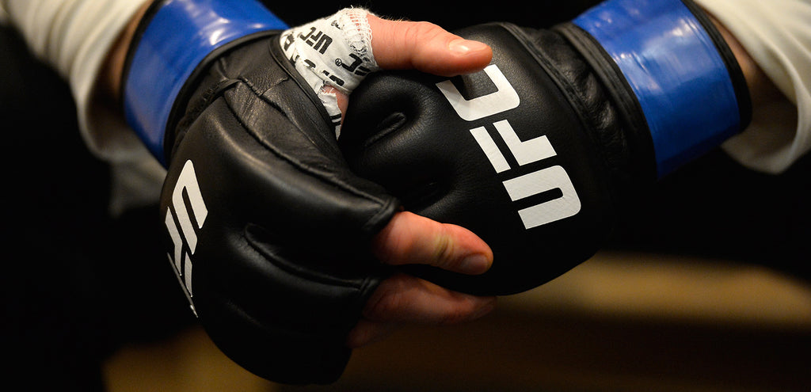
Remarks
Only took the most recent 5000 fights in the UFC for simplicity's sake
(10000 entries, since there are two outcomes per fight)
Amateur and other organizational fights are not recorded, and not counted towards the fighter’s record.
Some bouts are recorded as CatchWeight
Catchweight – a weight limit that does not fall within the weight class divisions
i.e When a fighter is not able to make their weight class, they can fight at a “catchweight”, this is due to the fighters not being able to make the agreed upon weight before the bout. Results in the overweight fighter losing his fighter compensation.
Weight classes are as follows:
Strawweight 115lbs, Flyweight 125lbs, Bantamweight 135lbs, Featherweight 145 lbs, Lightweight 155lbs, Welterweight 170lbs, Middleweight 185 lbs, Light Heavyweight 205 lbs, Heavyweight Under 265 lbs

Slide 8
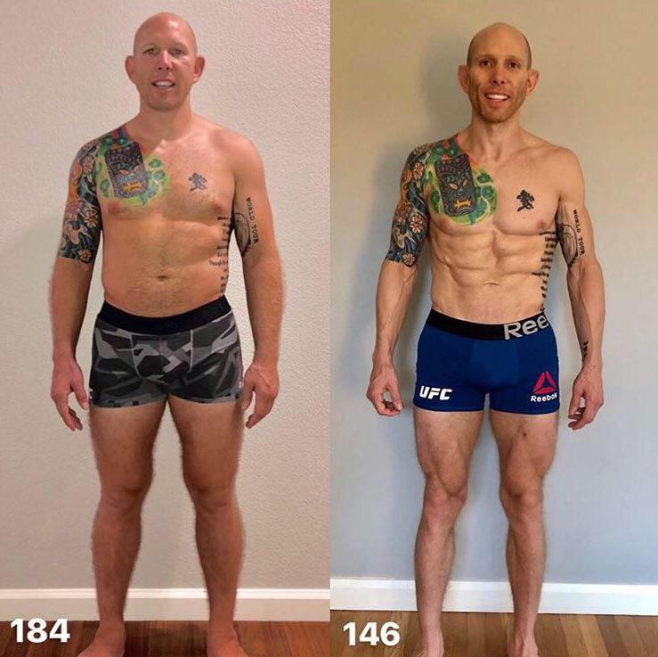
Limitations
This being an observational study, hence there exists several unmeasured confounders that can introduce bias and affect the accuracy of predictions
This number is unknown though we can list some potential unmeasured confounders that could influence the likelihood of getting TKO/KOed
These include:
1. Training Intensity & Quality
2. Fight Camp Preparation
3. Weight Cuts
4. Mental & Emotional State
5. Injury Status

Slide 9
Data Cleaning
Removed any null or missing entries for the events
Organized the sheets by fighter weight
Sorted the data by two variables:
Treatment Variable: Experienced a KO/TKO loss
Control Variable: Never experienced a KO/TKO loss
Added a separate column for the total number of fights
Not concerned with bouts that ended in a NC( no contest) , or DQ ( disqualification ), would be a bit hard to measure and would involve further inspection

Slide 10
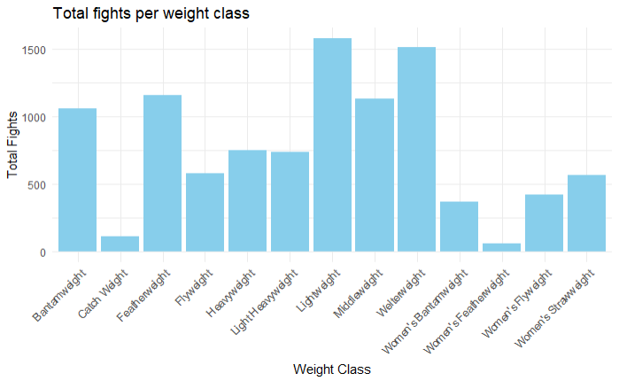
Initial Findings

Slide 11
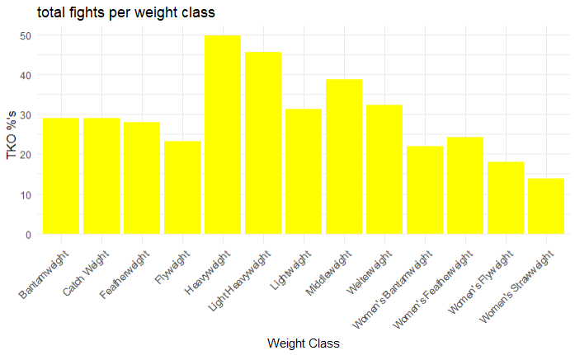
Initial Findings

Slide 12
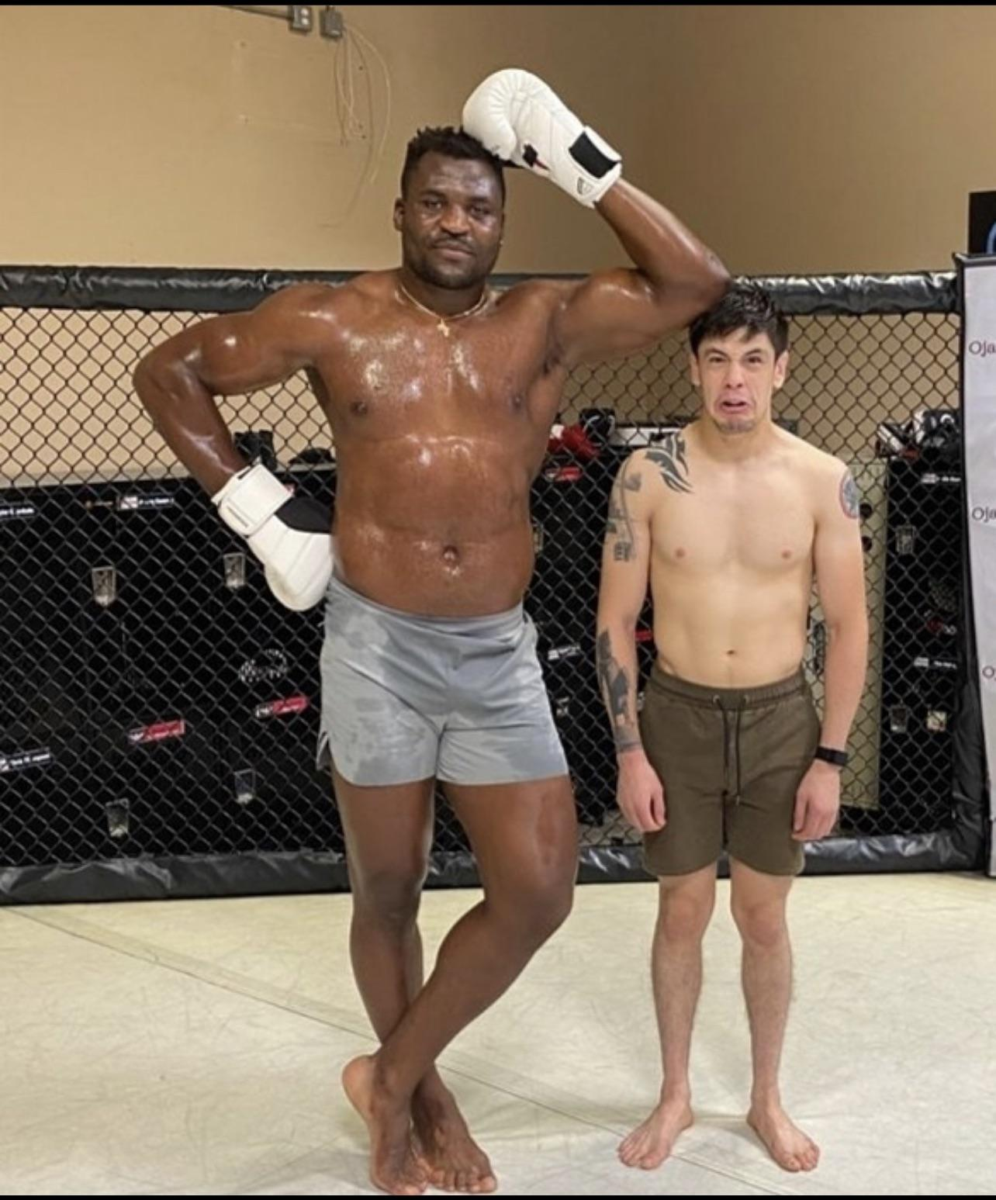
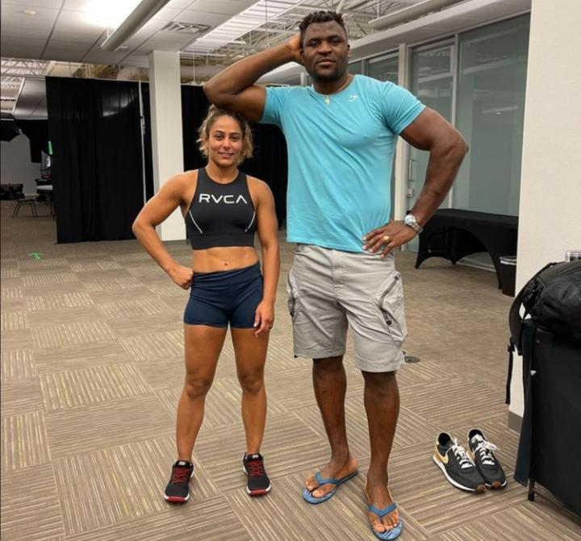
Notable facts
- Highest Percentage of TKO/KO’s occur in the heavyweight division, roughly 50% of all fights in that weight class end by TKO/KO
- Least Percentage of TKO/KO’s occur in the both the lightest weight classes for both females and males, respectively 125 lbs for Males, and 115 lbs for Females
- There are more fights occurring at Lightweight (155lbs) than any other weight class, this is also backed up the by fact that Lightweight is the most achievable weight class for most people considering genetics

Slide 13
Methodologies explored
Observational Study (refer to Linbo’s Lecture 3 )
PSM
- Matching ( Nearest Neighbors )
- PSM was utilized to reduce the impact of confounding variables, balance observed covariates between our treatment and control groups
2. Regression
- used regression to find the causal effect of being KO/TKOed based on previous KO/TKO losses

Slide 14
Analysis of results
Regression – Knocked had a -62.9 coef, it is the variable that has the most significant impact on you losing by TKO/KO
- Age – Age had a -29.9 coef
- Fighter Stance – orthodox stance -20.0 coef
Regression ( on matched pairs)
- propensity score for those that got knocked is at least 75% for matched pairs
- propensity score for those who have not been knocked out, follows a normal distribution
PSM (NN) – Three variables, SLpM, TDAcc, TDDef, were the only variables that were balanced after getting the means of the matched pairs as well as running t-tests
SLpM - Significant Strikes Landed per Minute
TDAcc – Takedown accuracry
TDDef – Takedown defense

Slide 15
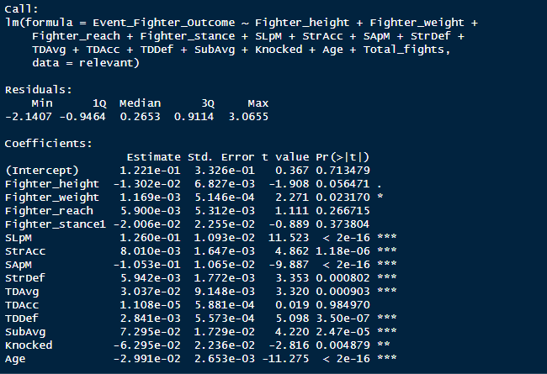
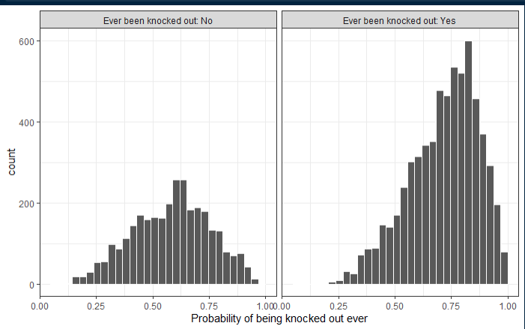
Results

Slide 16
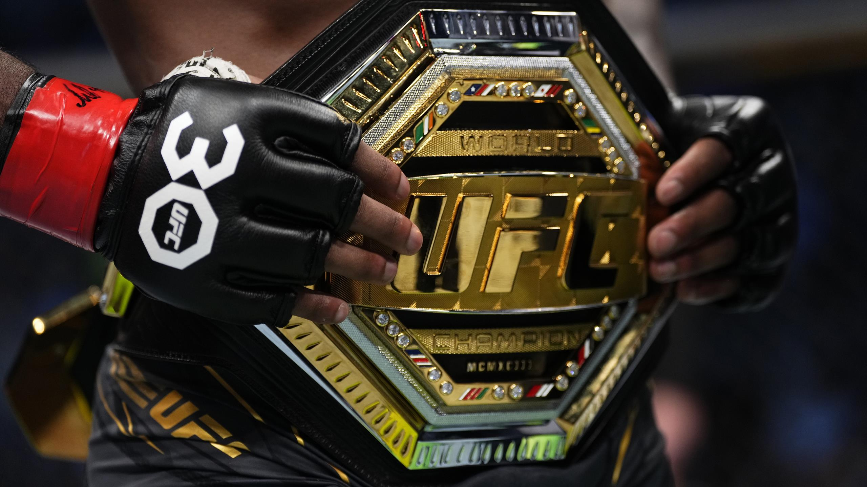
Conclusion
- If you want to have a long and successful UFC career, you should try to avoid getting knocked out, stay relatively young and be as light of a weight as possible, an increase in either one of these variables will contribute to the chances of you suffering a KO/TKO loss
- Being knocked out not only disrupts your longevity but will also reflect on your future performances significantly

Slide 17

Future Work
- Adhere to any feedback given by peers/professor and adjust accordingly
- Put models to the test for the upcoming UFC card ( UFC events are hosted every week ) and try to predict which fighter will get KO/TKOed
- Utilizing other propensity score methods to increase accuracy and reduce bias

Slide 18

Thank you for listening

Slide 19
References + Images
- https://twitter.com/TonyFergusonXT/status/1055714956568489984
- https://www.reddit.com/r/ufc/comments/qc04j3/the_size_difference_between_the_smallest_and/
- http://ufcstats.com/statistics/events/completed
- https://www.ncbi.nlm.nih.gov/pmc/articles/PMC6537320/
- https://www.reddit.com/r/ufc/comments/qv72hg/heavyweight_francis_ngannou_standing_next_to/
- https://www.reddit.com/r/ufc/comments/10zu4t4/josh_emmetts_weight_cut_is_brutal_wtf/
- https://www.youtube.com/watch?app=desktop&v=EHwWO0kWkg0
- https://www.reddit.com/r/ufc/comments/qe8clv/if_the_ufc_rebranded_and_had_an_nbastyle/
- https://ufcstore.com/collections/ufc-equipment-gloves
- https://www.linkedin.com/pulse/how-increase-your-chances-winning-football-betting-deepak-gupta/
- https://www.eurosport.com/mixed-martial-arts/ufc/2023/ufc-world-champions-2023-who-are-the-current-belt-holders-which-belts-do-jon-jones-alexa-grasso-hold_sto9660682/story.shtml

